Slide 1
Download PDF off of Gmail

Slide 2

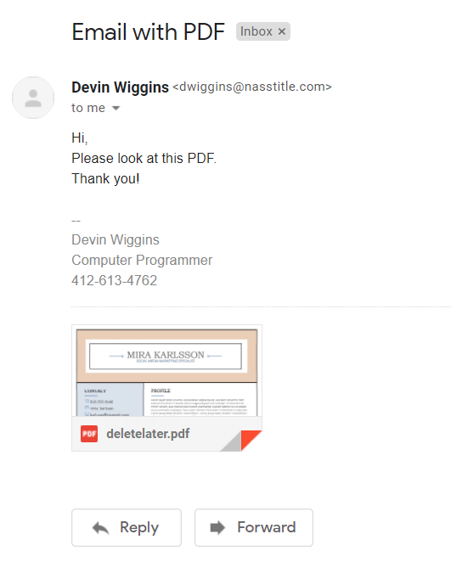
Open the Email
Open the email that has the PDF attachment.
After it is opened, you will see this screen:

Slide 3
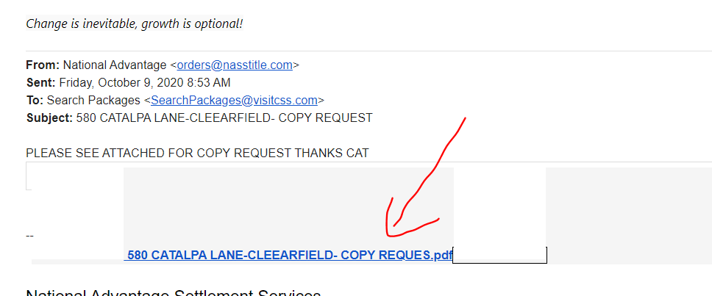
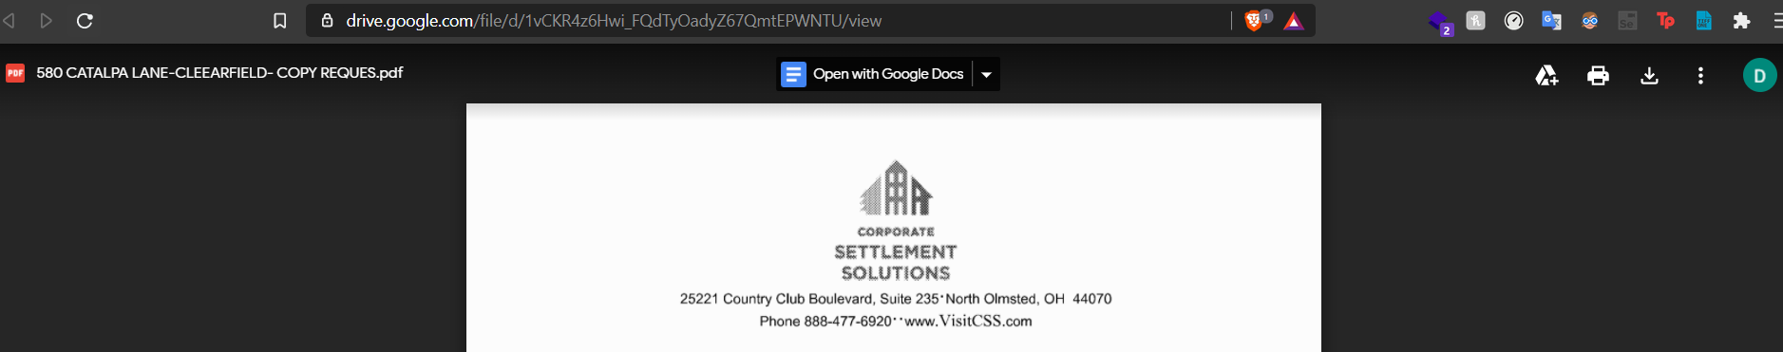
Open the hyperlink for the PDF
Scroll to the hyperlink for the PDF attached. It should look like this:
It should then open a page like this:

Slide 4
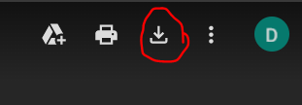
Download PDF from the Page
After you opened the PDF through the link, move your mouse to the “download” button in the top right. It should look like the circled icon:
After clicking the “download” button, it will open a new page that will start the download.

Slide 5
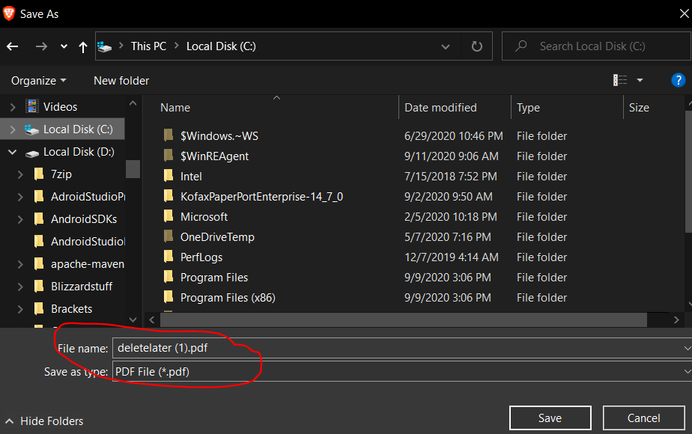
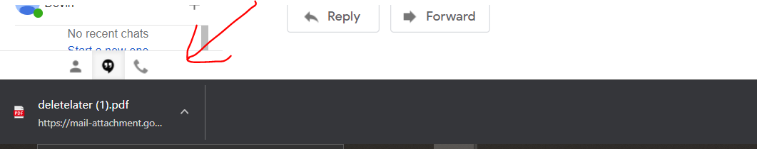
Save the PDF
After clicking the “download” button, you may be prompted to save the PDF in your desired location, you will get a pop-up like this:
If you don’t get the popup, it should automatically download and you will see this message on the bottom of your screen

Slide 6
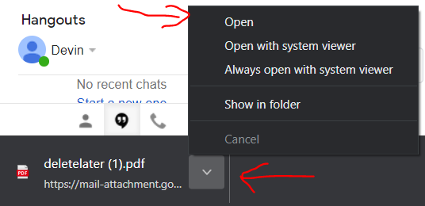
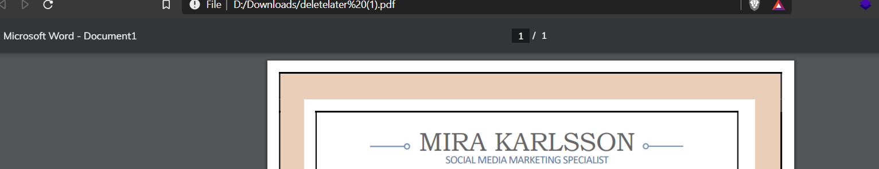
Open the downloaded PDF
After it successfully downloads, click the up-arrow on the pop up and you will see this
Click “Open” at the top, and you should see the file opened in your browser

Slide 7
If the PDF is an attachment, use the below slides

Slide 8
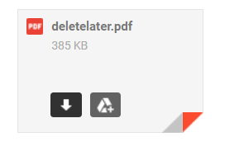
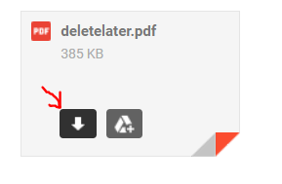
Download the PDF through the attachment
To download the PDF, first scroll down to the bottom of the email and find the attachment, then hover your cursor over the attachment you want to download
Next, click the “download” button on the left of the attachment

Slide 9
Save the PDF
After clicking download, you may be prompted to save the PDF in the desired location, you will get a pop-up like this:
If you don’t get the popup, it should automatically download and you will see this message on the bottom of your screen

Slide 10
Open the downloaded PDF
After it successfully downloads, click the up-arrow on the pop up and you will see this
Click “Open” at the top, and you should see the file opened in your browser

